Slide 1
M251 PROGRAMMING GUIDE

Slide 2
Agenda
Test Environment
Program
Test Tool
SMBUS Command

Slide 3
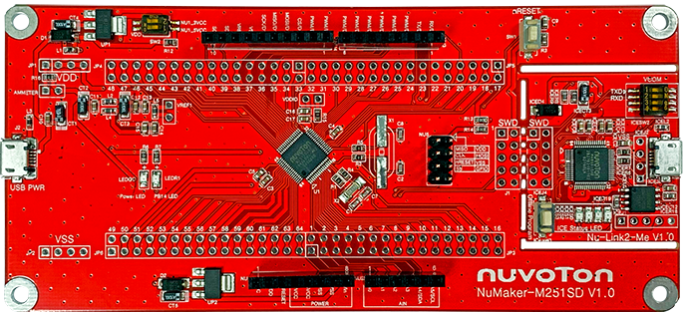
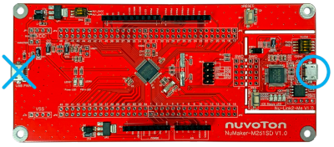
Test Environment
Use the NuMaker-M2L31KI development board.
Connect the ICE USB connector to the PC USB port through USB cable.
Use pin 27 as PEX_SMCLK and pin 28 as PEX_SMDAT to SMBUS. Or connect to the Nu-Link2-Pro to use the test tool.
Use pin 39 as MCU_0_SCL and pin 40 as MCU_0_SDA to INA3221.

Slide 4
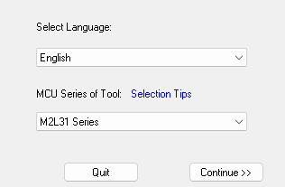
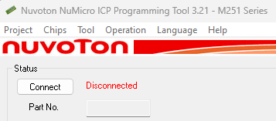
Program
Use ICP Programming Tool
https://www.nuvoton.com/resource-download.jsp?tp_GUID=SW1720200221181328
Install and execute
Select “M2L31 Series” and click the “Continue” button
Click the “Connect” button

Slide 5
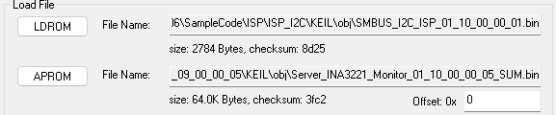
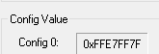
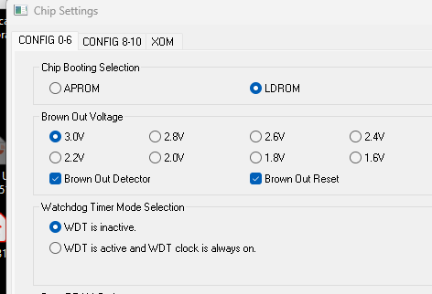
Program
Click the “APROM” and “LDROM” button and select the target file.
Check “Chip Settings” value. Config boot in ldrom enable, and BOD

Slide 6
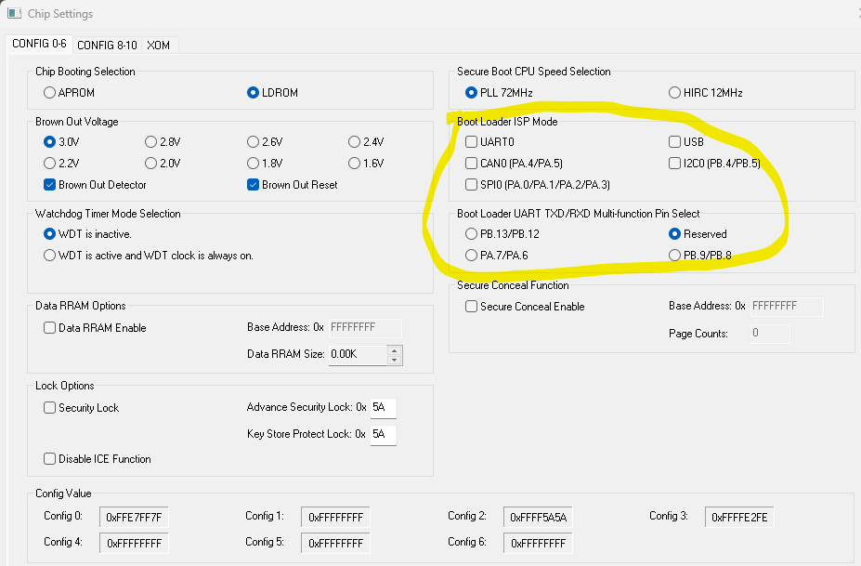
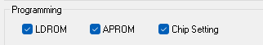
Program
Disable boot loader
Set “APROM”, “LDROM” and “Chip Setting”. And start program

Slide 7
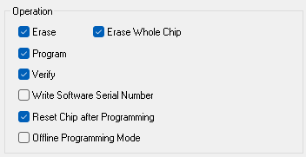
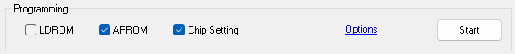
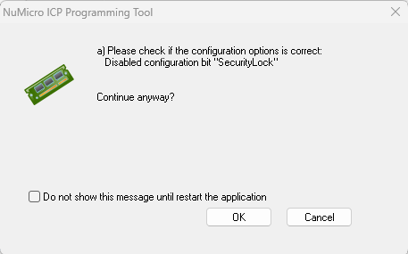
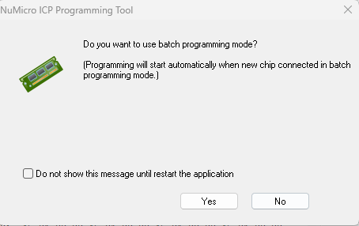
Program
Click the “Options” and set setting shown as right.
Click the “Start” button. Click the “OK” and “No” button when it shows the below messages.

